Slide 1

Design and Implementation of AI Security Scheme for Connected Vehicles
Mohamed Saied
Under Supervision of
Prof. Dr Hoda Korashy
Dr Khaled Youssef

Slide 2
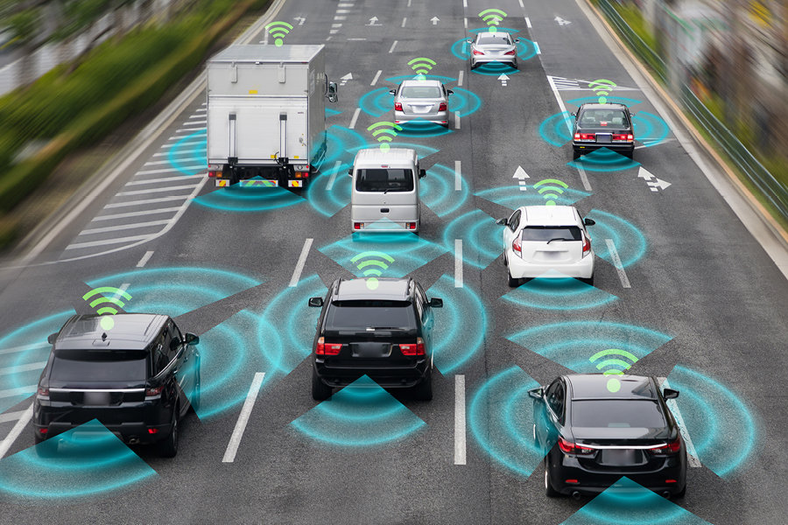
Connected Vehicles
Vehicles on the road exchange basic safety messages among each other to avoid collision.
This happens through a wireless broadcasting protocol called Dedicated short range communication(DSRC).
Which increases vehicles vulnerability.
Our goal to make the road more safer and increase Car security.

Slide 3
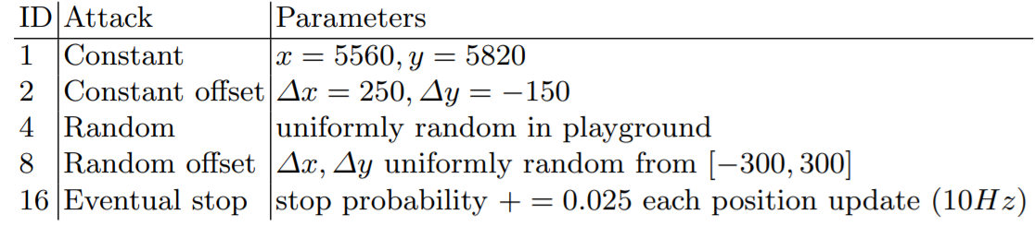
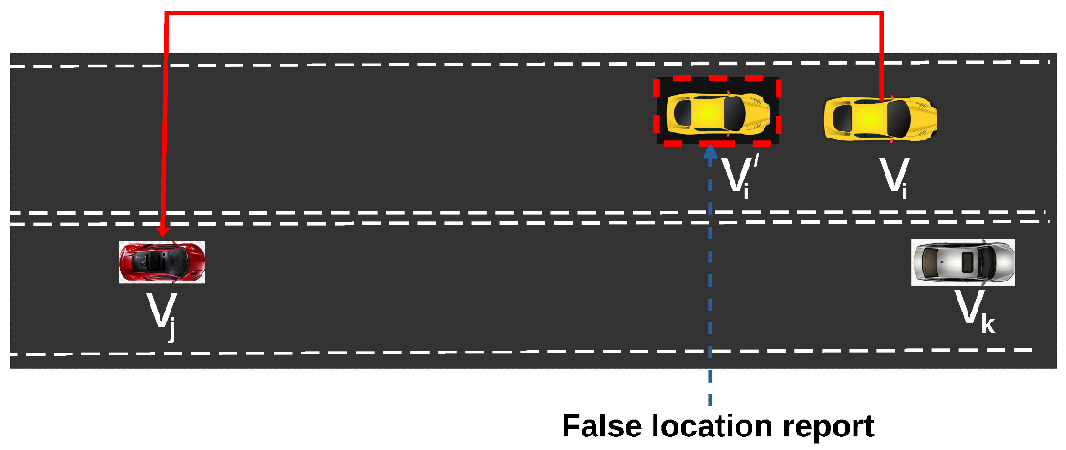
Types of Attack
In this project we demonstrate 6 types of attack using VeReMi dataset

Slide 4
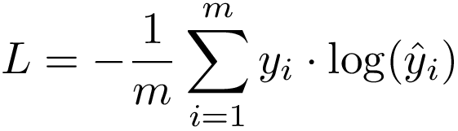
Proposed Algorithm
Multi-Layer Perceptron is used with 4 inputs and 6 outputs
Three Layers: input layer and One Hidden Layer with relu activation
And one output layer
Objective function is cross entropy
Cross validation 80% training 20% testing

Slide 5
Block Diagram
Normalization
Label Binarization
MLP
evaluation
input

Slide 6
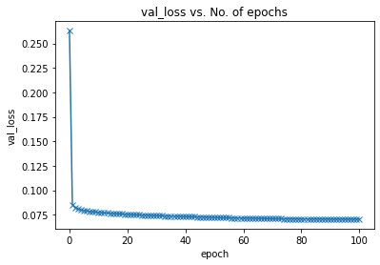
Results
100 epochs
Learning Rate 1e^-2
Minimum Loss reached: 0.0704

Slide 7
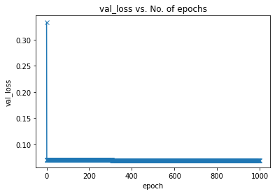
Results Cont’
Training for 1000 epochs
With learning rate of 1e^-3
Minimum Loss reached: 0.0695

